Slide 1


Slide 2





Ujarzmiamy strumień danych.
Wprowadzenie do AKKA Streams
Britenet
2022

Slide 3


Stream processing

Slide 4
Stream processing
Stream processing refers to processing of continuous stream of data immediately as it is produced. It analyzes streaming data in real time. Stream processing is used when the data size is unknown and infinite and continuous. It takes few seconds or milliseconds to process data. In stream processing data output rate is as fast as data input rate. Stream processor processes data in few passes. When data stream is continuous and requires immediate response then in that case stream processing is used

Slide 5

Challenges with Stream processing
Data input rate and output rate sometimes creates a problem.
Cope with huge amount of data and immediate response.

Slide 6

Everything is Graph… Let’s talk about source, flow and sink

Slide 8


Slide 9
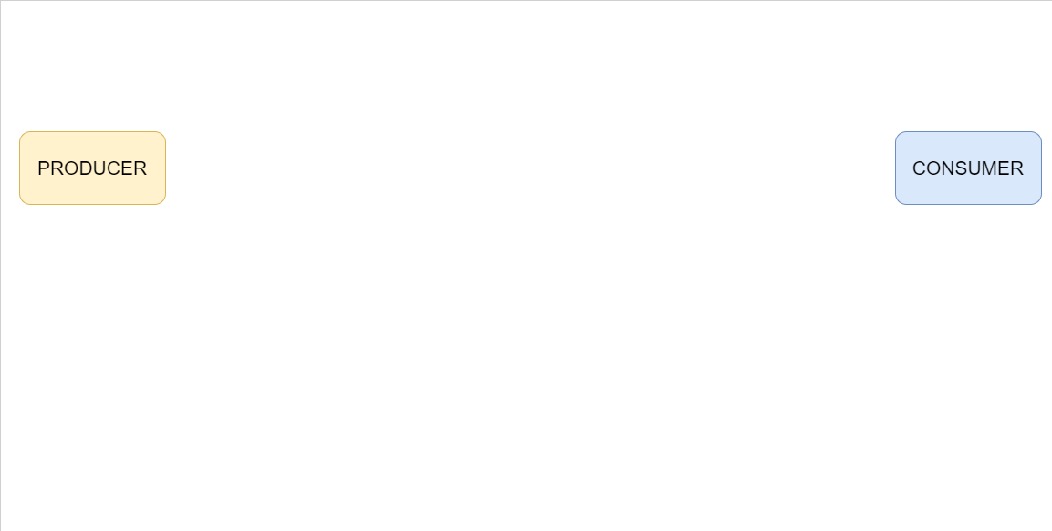

Slide 10
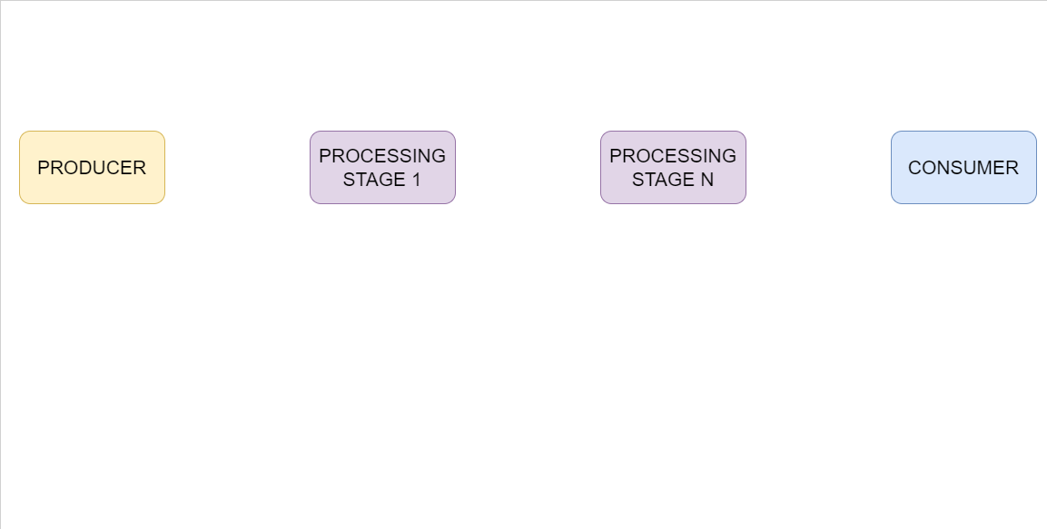

Slide 11
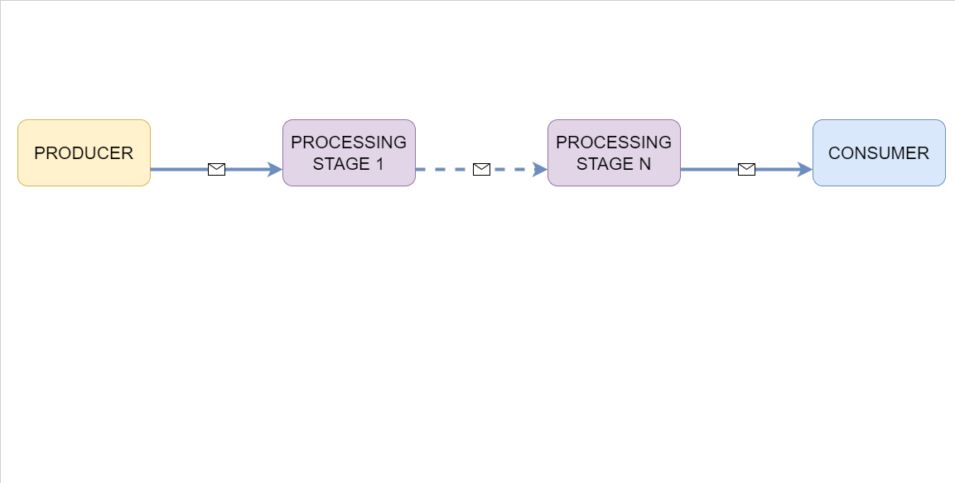

Slide 12
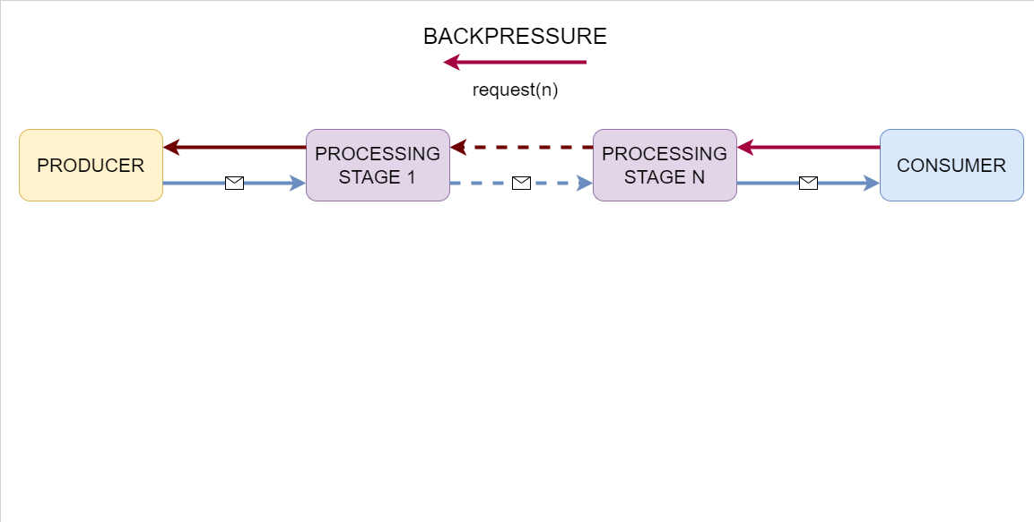

Slide 13
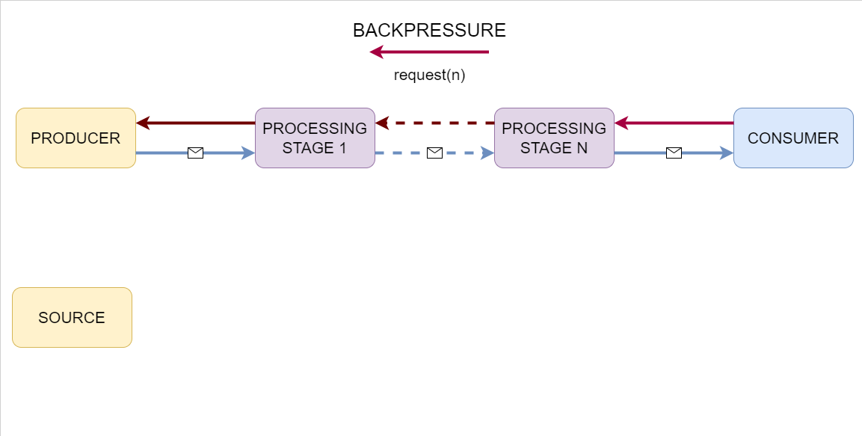

Slide 14
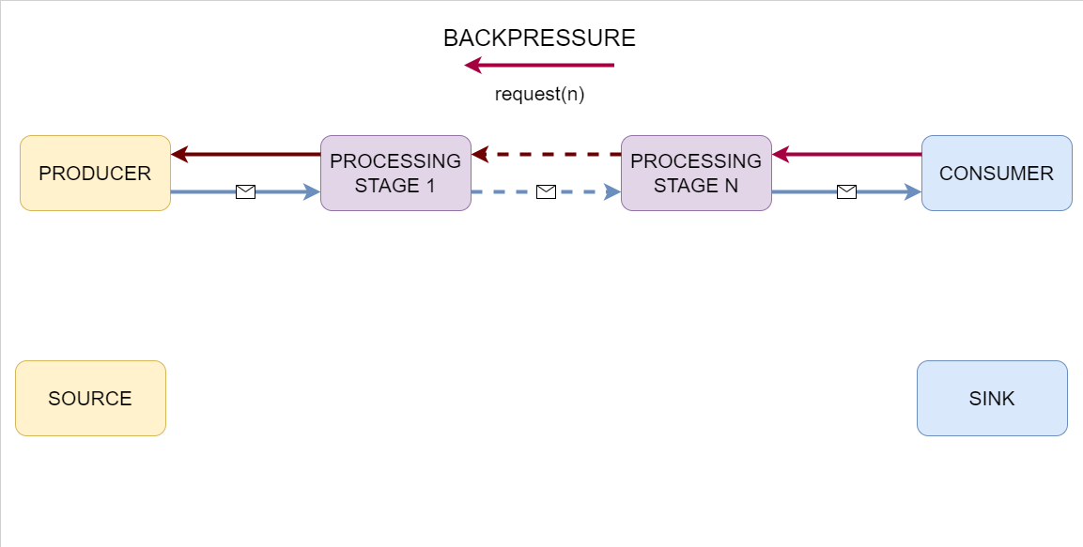

Slide 15
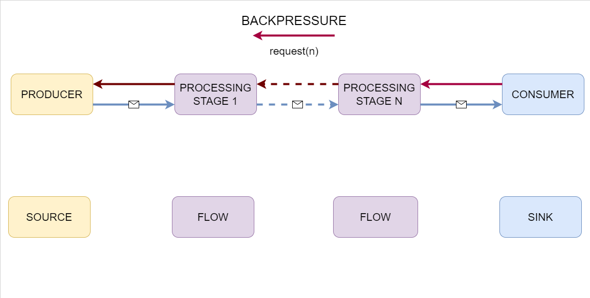

Slide 16
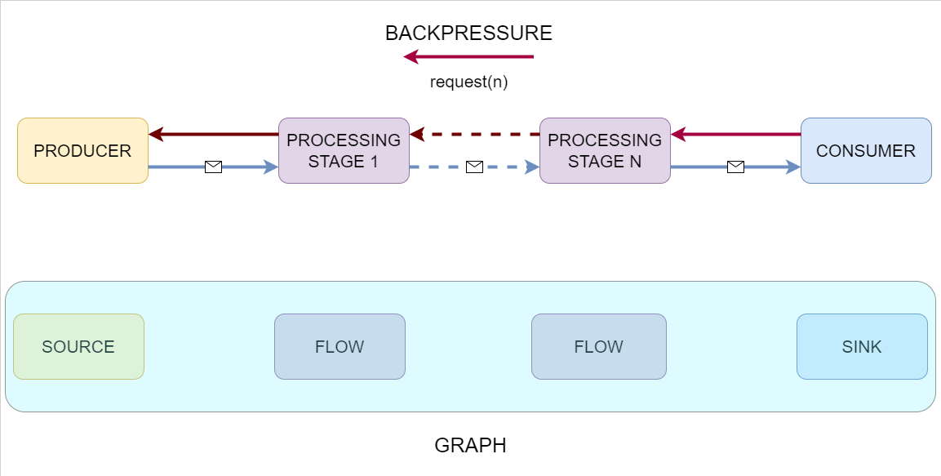

Slide 17

Use
case

Slide 18
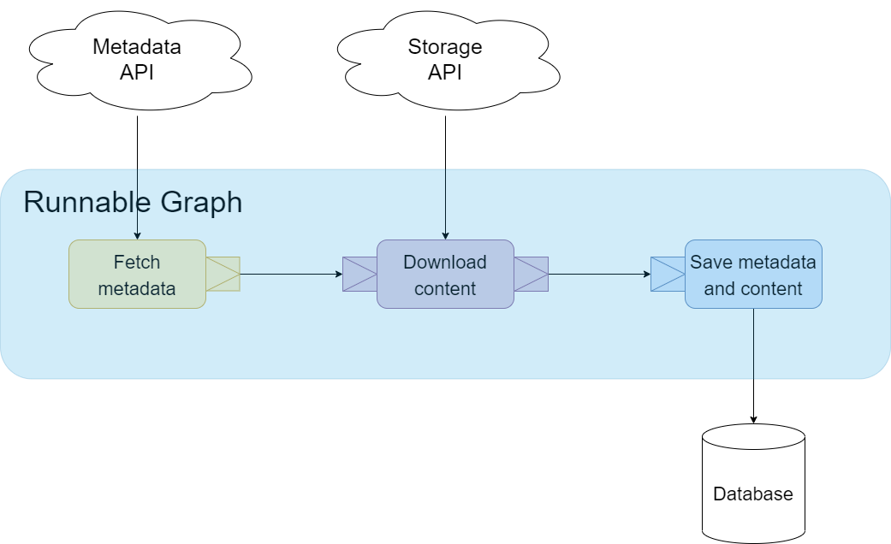
Tytuł rozdziału

Slide 19


Kontakt
Karolkowa Business Park ul. Karolkowa 30 01-207 Warszawa
Mariusz Przybysz
.NET Developer
mariusz.przybysz@britenet.com.pl

Slide 20
Thanks
https://github.com/mariuszKrzysztofPrzybysz/MasterClass2022_Metadata
https://github.com/mariuszKrzysztofPrzybysz/MasterClass2022_Storage
https://github.com/mariuszKrzysztofPrzybysz/MasterClass2022_Client
https://getakka.net/

Slide 21






Pieczątki

